Slide 1
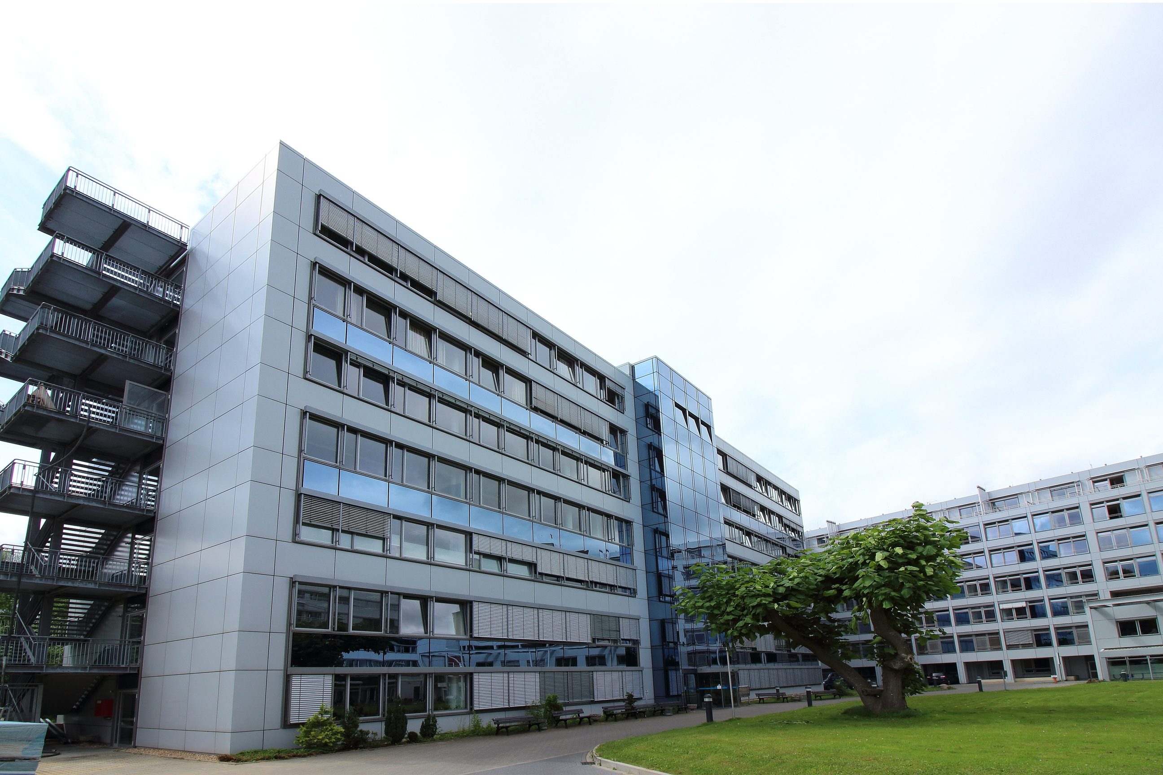
HEALTH SERVICE
PROPOSAL
Comprehensive Healthcare Solutions for Better Patient Outcomes
Presented by Dynamo Pixel

Slide 2

ABOUT US
Healthcare is a leading provider of integrated medical services dedicated to delivering high-quality, patient-centered care. With modern facilities and experienced professionals, we strive to improve community health through accessible and affordable services.
To provide compassionate healthcare that combines advanced medical technology with personalized attention.

Slide 3



MEET OUR TEAM
Cahaya Dewi
Soo Jin Ae
Richard Sanchez
Doctor
Head of division
Secretary
Experienced physician with over 12 years in general medicine and patient care management.
Senior specialist overseeing medical operations, ensuring highest standards of diagnosis and treatment.
Manages smooth operations, patient coordination, and ensures efficient service delivery.

Slide 4



INPATIENT
Our inpatient department provides round-the-clock medical care in a comfortable and safe environment for patients requiring hospital admission.
24/7 monitoring by qualified doctors
Health screening and preventive care
MEDICINE SERVICE
MEDICAL EXAMINATION
We offer comprehensive outpatient and general medicine services for the prevention, diagnosis, and treatment of various health conditions.
General medical consultations
Health screening and preventive care
Accurate and timely diagnosis is essential for effective treatment. We provide a wide range of medical examination and diagnostic services.
Complete health check-up packages
Laboratory and pathology tests

Slide 5

PERCENTAGE OF HEALTH CARE NEEDS
Understanding community health requirements helps us deliver targeted and effective services.
Our services are strategically designed based on actual community health demands, with the highest focus on prevention and early intervention for better long-term health outcomes.

Slide 6
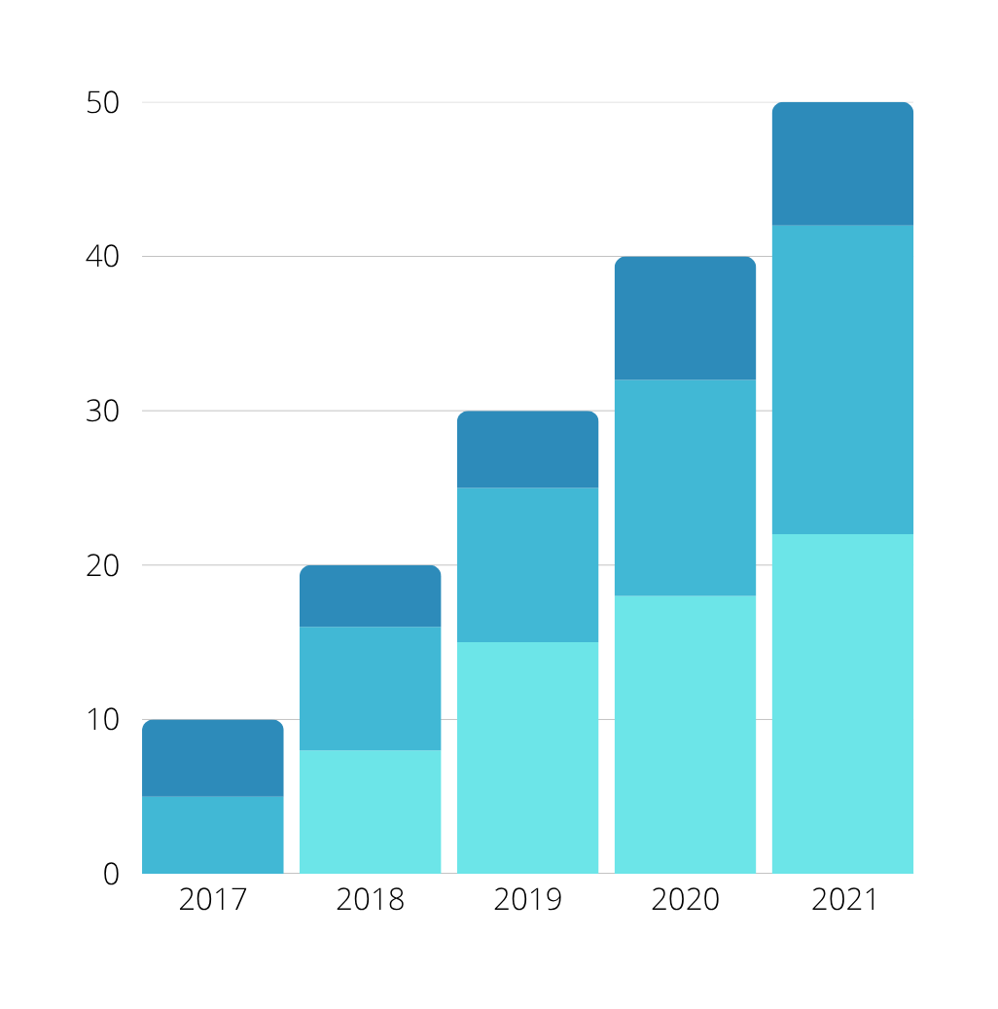
Understanding Healthcare Needs
Our services are designed based on real community
health requirements and data-driven insights.
DISTRIBUTION OF HEALTHCARE NEEDS
Preventive & Wellness Care: 35%
Chronic Disease Management: 25%
Acute & Emergency Care: 20%
Diagnostic Services: 15%
Specialized Treatments: 5%

Slide 7
CONTACT US
EMAIL ADDRESS
hello@healthcare.com
PHONE NUMBER
(123)456 7890
LOCATION
123 Anywhere St., Any City, ST 12345

Slide 8

THANK YOU

